Slide 1
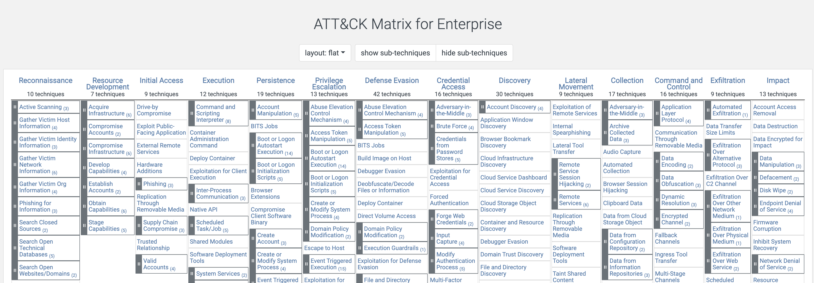
MITRE ATT&CK
https://attack.mitre.org/
Today we will be looking at Execution.

Slide 2
Execution

Slide 3

Execution
What is Execution phase:
This is where the attacker gets their code to run on a target system.
Sometimes things will flow from Initial Access to Execution fairly seamlessly and other times there is distinct delineation between these steps.
A variety of methods can be utilized:
T1059 via scripting is very common (PowerShell, CMD, VB, Python, JS, etc.)
T1024 via User Execution is also very common (user clicks, opens, runs, etc.)
Other methods in this category include WMI, abuse of system services, serverless execution, malicious container deployment – the list goes on.
This Photo by Unknown Author is licensed under CC BY-SA-NC

